Slide 3
History
of the Church
SEVENTH DAY ADVENTIST | Ellen White 1831 CE
BAPTIST | John Smyth 1609 CE
SOUTHERN | 1845
AMERICAN | 1924
PRESBYTERIANS | John Knox 1538 CE
LUTHERAN | Martin Luther 1517 CE
MENNONITE | Menno Simons 1537 CE
MENNONITE BRETHREN | 1860 CE
AMISH| Jakob Ammann 1693 CE
EASTERN ORTHODOX
UNDIVIDED CHURCH
ROMAN CATHOLIC
ANGLICAN | Henry VIII 1534 CE
CONGREGATIONAL | 1630
EPISCOPAL| 1789
METHODIST | John Wesley 1738 CE
SALVATION ARMY | 1865
CHURCH OF THE NAZARENE | 1895
JESUS
CHURCH OF GOD | 1897
PENTECOSTALS | Charles Parham 1900
ASSEMBLIES OF GOD | 1914
Assembled by Kyle Goings
controlled.chaosx2@gmail.com
FOURSQUARE | 1927
VINEYARD | 1983
30 CE
1000 CE
1500 CE
1700 CE
1800 CE
1900 CE
2000 CE

Slide 4
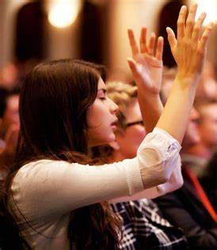
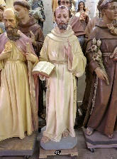
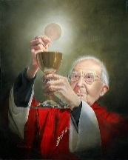
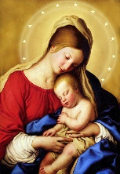
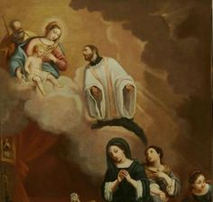
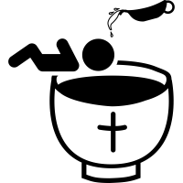
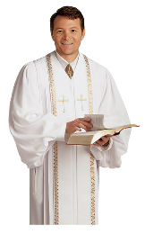
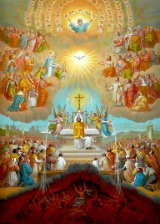
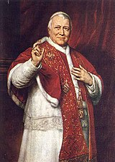
Differing Denominational Beliefs & Practices
Seventh Day Adventist
SATURDAY SABBATH
EVANGELICAL PROTESTANT
CHARISMATIC
BIBLE TEACHING
ICONS
TRANSUBSTANTIATION
BELIEVER’SBAPTISM
Baptist/Southern
Church of Christ
Mennonite/Brethren
Salvation Army
Assembly of God
Pentecostal
Foursquare Gospel
Vineyard USA
FORGIVENESS
EASTERN ORTHODOX
VENERIATION OF MARY
INTERCESSIONOF SAINTS
Methodist/Wesleyan
Episcopal/Anglican
Lutheran (ELS)
Disciples of Christ
Presbyterian
Quakers
National Baptist
COMMUNION
APOCRYPHA
ORDAINS
LGBTQ+
INFANT BAPTISM
ROMAN
CATHOLIC
LITURGICAL
MAINLINE
PROTESTANT
PURGATORY
PAPAL AUTHORITY
Inspired by CornerTalker and Compare the Beliefs of Christian Denominations by Mary Fairchild
Assembled by Kyle Goings controlled.chaosx2@gmail.com
ORIGINAL SIN

Slide 5
What’s Distinctive About Mennonite Brethren?

Slide 6
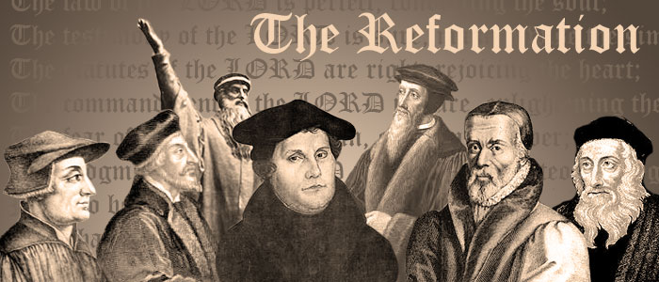
The Bible was put into print form so people could read it for themselves
God’s authority comes from Scripture alone, not from a priest or pope
Relationship with Jesus comes by grace through faith, not tradition
LUTHERAN | Martin Luther 1517 CE
1500 CE
1600 CE
1700 CE
1800 CE
1900 CE
2000 CE

Slide 7
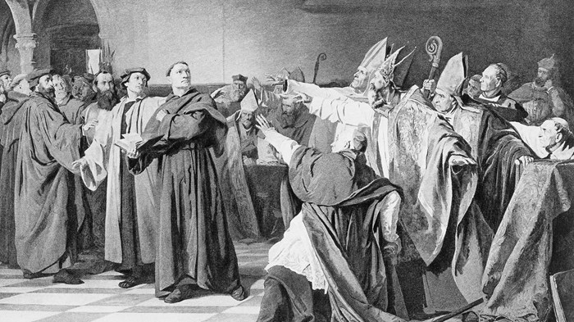
THE RADICALS:
They wanted to renew the Church and bring it back to what they read in the New Testament
LUTHERAN | Martin Luther 1517 CE
1500 CE
1600 CE
1700 CE
1800 CE
1900 CE
2000 CE

Slide 8
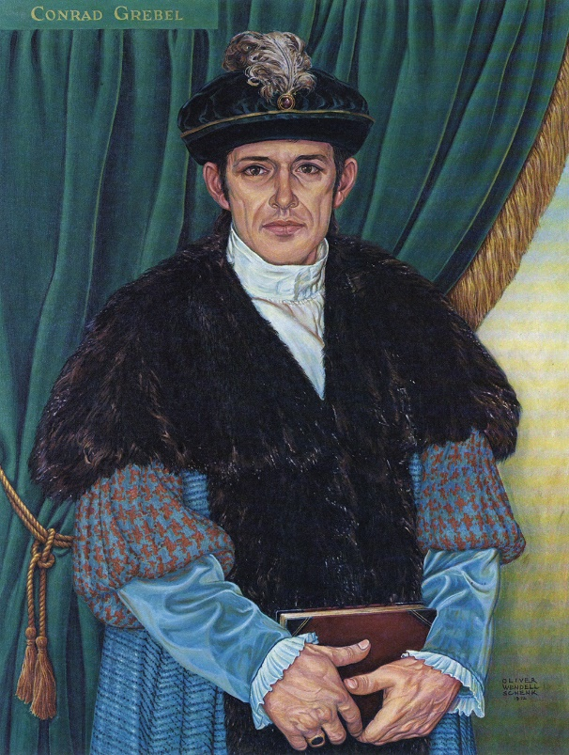
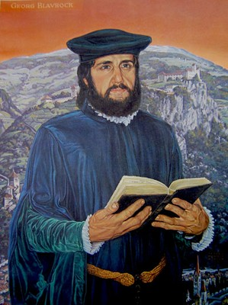
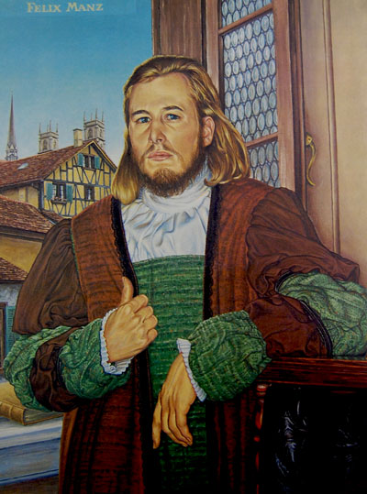
Conrad Grebel
George Blaurock
Felix Manz
LUTHERAN | Martin Luther 1517 CE
1500 CE
1600 CE
1700 CE
1800 CE
1900 CE
2000 CE

Slide 9
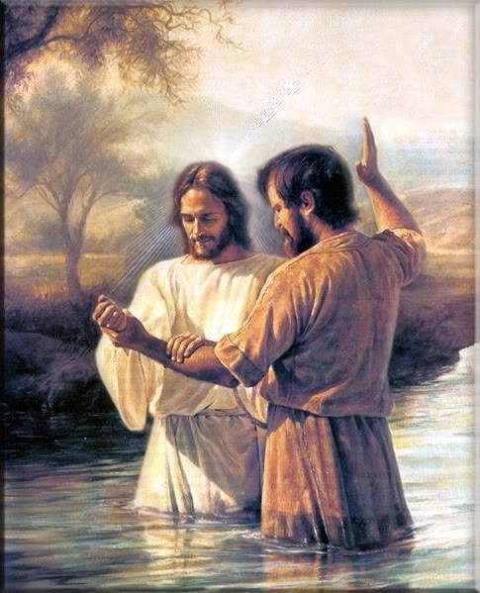
Conrad Grebel
George Blaurock
Felix Manz
Rejected infant baptism and read in the Scriptures that baptism is an expression of the faith of the believer
LUTHERAN | Martin Luther 1517 CE
1500 CE
1600 CE
1700 CE
1800 CE
1900 CE
2000 CE

Slide 10
Conrad Grebel
George Blaurock
Felix Manz
Rejected infant baptism and read in the Scriptures that baptism is an expression of the faith of the believer
The River Limmant
Zurich Switzerland 1525CE
They baptized each other
LUTHERAN | Martin Luther 1517 CE
1500 CE
1600 CE
1700 CE
1800 CE
1900 CE
2000 CE

Slide 11
To the Church/State this act was treason
so they were hunted down and murdered
The River Limmant
Zurich Switzerland 1525CE
LUTHERAN | Martin Luther 1517 CE
1500 CE
1600 CE
1700 CE
1800 CE
1900 CE
2000 CE
Notes:
Felix Munz – was asked to recant – and he refused so when he looked out to his family – they held their arms up with the fingers together – signifying true to Christ

Slide 12
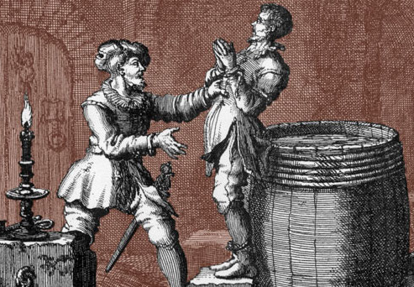
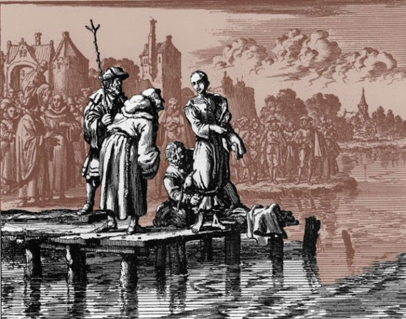
To the Church/State this act was treason
so they were hunted down and murdered
The River Limmant
Zurich Switzerland 1525CE
LUTHERAN | Martin Luther 1517 CE
1500 CE
1600 CE
1700 CE
1800 CE
1900 CE
2000 CE
Notes:
Felix Munz – was asked to recant – and he refused so when he looked out to his family – they held their arms up with the fingers together – signifying true to Christ

Slide 13
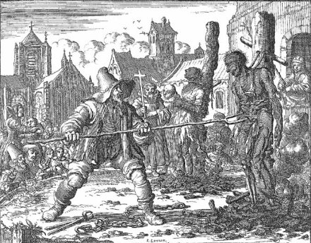
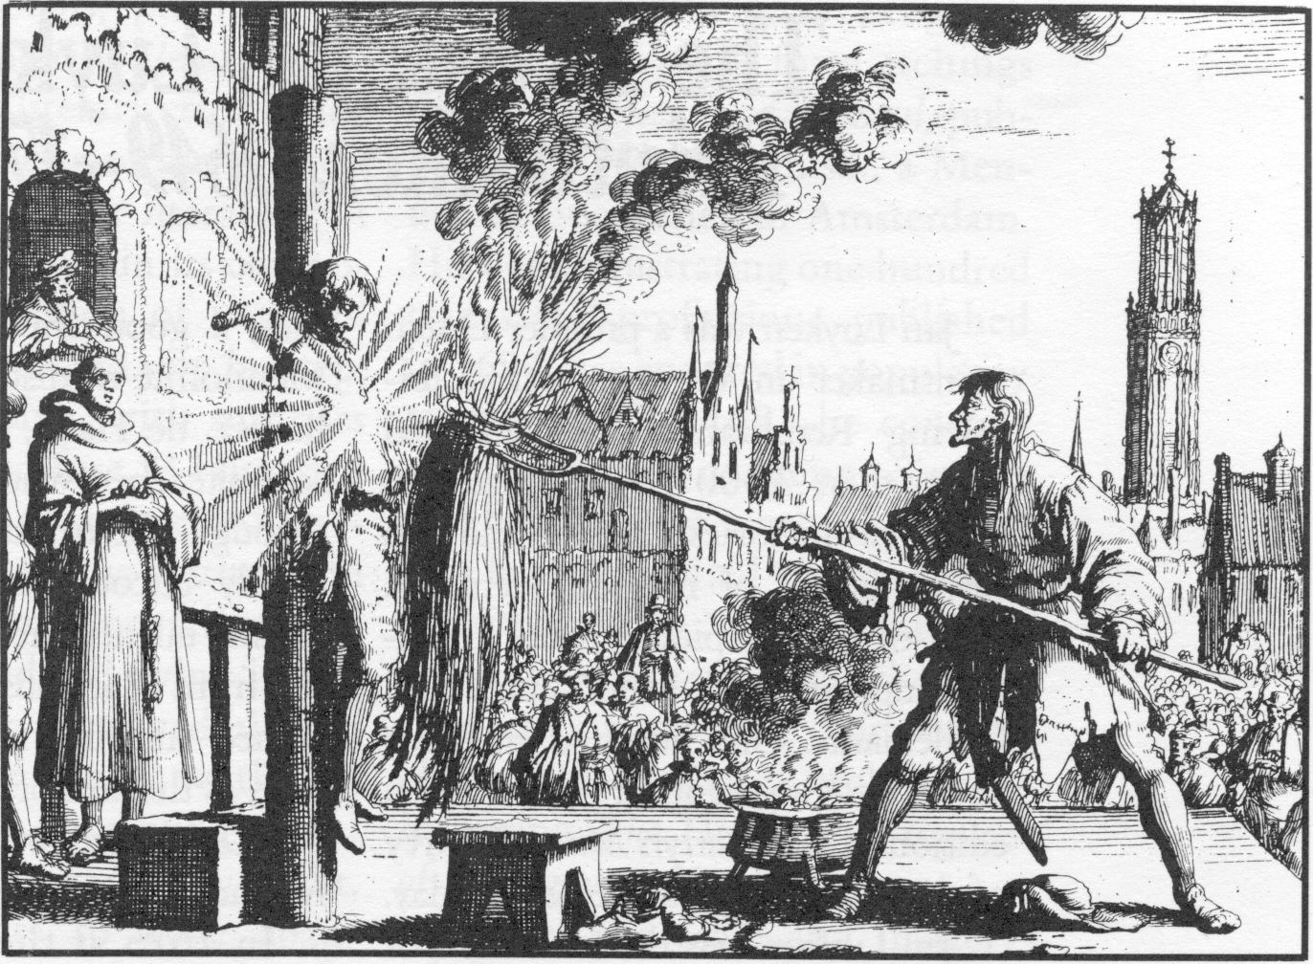
A time of harsh persecution followed,
but the movement grew stronger
“Anabaptist” means “re-baptized”
ANABAPTIST PERSECUTION | 1525 CE
LUTHERAN | Martin Luther 1517 CE
1500 CE
1600 CE
1700 CE
1800 CE
1900 CE
2000 CE
Notes:
Felix Munz – was asked to recant – and he refused so when he looked out to his family – they held their arms up with the fingers together – signifying true to Christ

Slide 14
A former Catholic Priest from the Netherlands starting
preaching and writing about this radical faith
MENNONITE | 1537 CE
LUTHERAN | Martin Luther 1517 CE
1500 CE
1600 CE
1700 CE
1800 CE
1900 CE
2000 CE
Notes:
He began preaching and writing about this radical faith and he gain
His followers were called “Little Mennos”

Slide 15
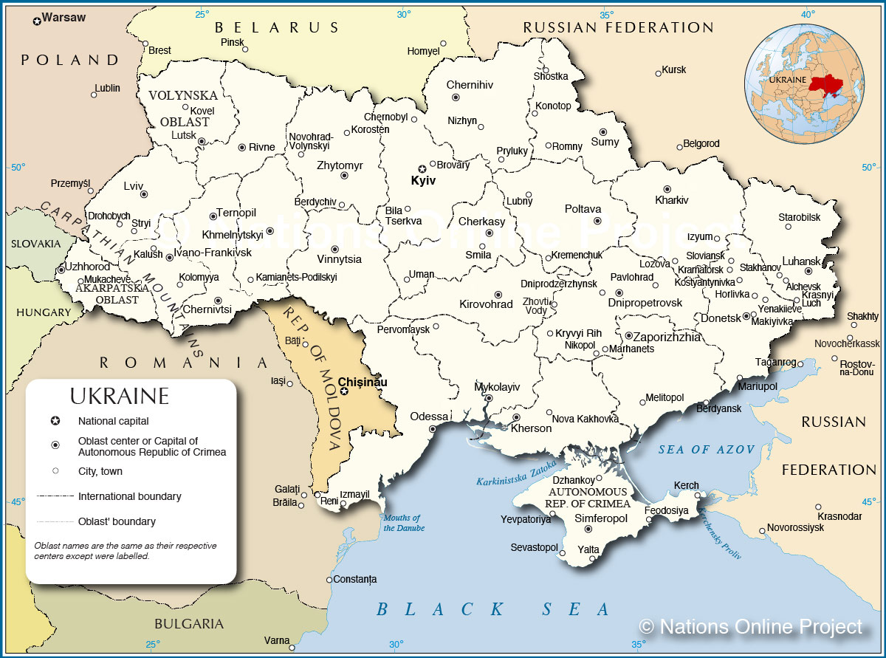
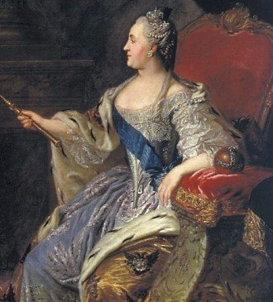
To avoid continued persecution they accepted an invitation from Czar Catherine The Great
Migrated to Ukraine 1780’s CE
MENNONITE | 1537 CE
LUTHERAN | Martin Luther 1517 CE
1500 CE
1600 CE
1700 CE
1800 CE
1900 CE
2000 CE
Notes:
Reclaim some swamp land and turn it into farmland and in exchange they can continue to speak german and didn’t have to participate in Russian government or military.

Slide 16
Prosperity
MENNONITE | 1537 CE
LUTHERAN | Martin Luther 1517 CE
1500 CE
1600 CE
1700 CE
1800 CE
1900 CE
2000 CE

Slide 17
Spirituality
Prosperity
MENNONITE | 1537 CE
LUTHERAN | Martin Luther 1517 CE
1500 CE
1600 CE
1700 CE
1800 CE
1900 CE
2000 CE

Slide 18
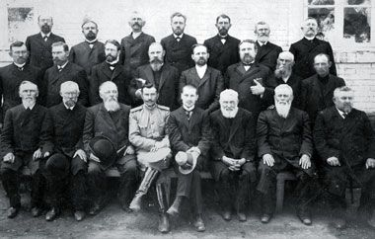
Influenced by a traveling preaching, 17 men were trying to convince other believers that they need to “get back to the scriptures and following Jesus”
Ridiculed as
“The Brethren”
MENNONITE BRETHREN | 1860 CE
MENNONITE | Menno Simons 1537 CE
LUTHERAN | Martin Luther 1517 CE
1500 CE
1600 CE
1700 CE
1800 CE
1900 CE
2000 CE

Slide 19
The Great Migration
1874-1884 CE
MENNONITE BRETHREN | 1860 CE
MENNONITE | Menno Simons 1537 CE
LUTHERAN | Martin Luther 1517 CE
1500 CE
1600 CE
1700 CE
1800 CE
1900 CE
2000 CE
Notes:
They were farmers so they landed in agricultural regions

Slide 20
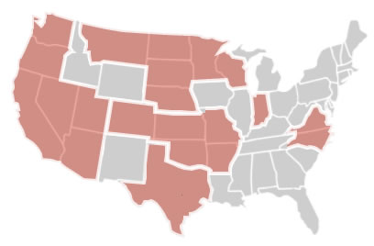
MODERN TIMES:
India: 212,000
Congo: 102,100
Thailand: 42,000
Canada: 36,000
200+ Churches in the US
35,000+ Believers
20+ Countries
500,000+ Believers
MENNONITE BRETHREN | 1860 CE
MENNONITE | Menno Simons 1537 CE
LUTHERAN | Martin Luther 1517 CE
1500 CE
1600 CE
1700 CE
1800 CE
1900 CE
2000 CE
Notes:
They were farmers so they landed in agricultural regions

Slide 21
What’s Distinctive About Mennonite Brethren?
Prioritizes scripture and the teachings of Jesus
Proclaims the Gospel in our decisions, words, and actions
Emphasizes missional work (locally and globally)
Believe the way of the gospel is the way of peace & reconciliation
Emphasizes community and togetherness
MENNONITE BRETHREN | 1860 CE
MENNONITE | Menno Simons 1537 CE
LUTHERAN | Martin Luther 1517 CE
1500 CE
1600 CE
1700 CE
1800 CE
1900 CE
2000 CE
Notes:
3. Works for the good of people (Christians and non-Christians) Not just for us to God but also with each other
500 years ago when other people were burning people for believing the wrong things our family said there must be abetter way

Slide 22
When Someone Asks You What Church Do You Go To What Do You Say?

