Slide 3
Why Do We Have So Many Different DENOMINATIONS?

Slide 4
Denomination:
Latin denominare meaning “to name”
Religious organization that unites local congregations in a single, legal, and administrative body.

Slide 5
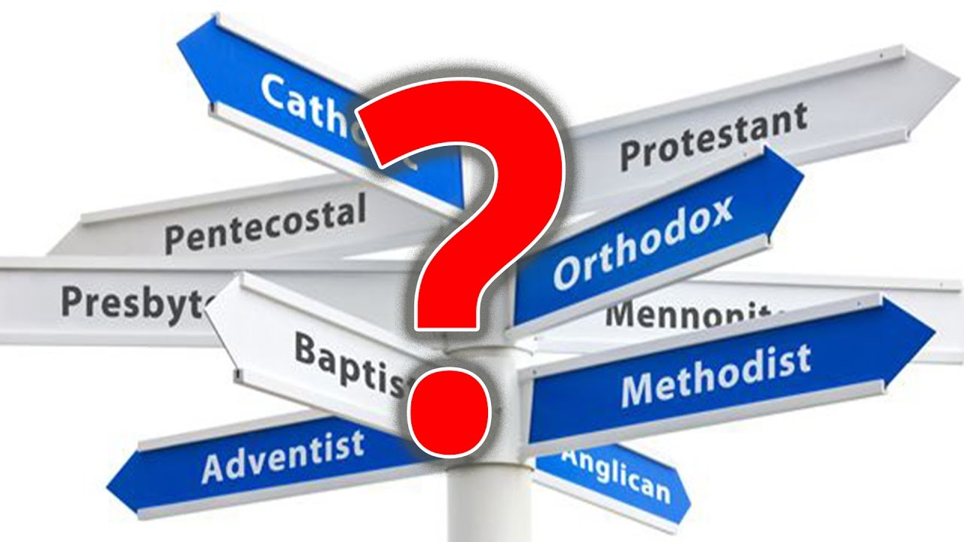

Slide 6
2,500,000,000 Attendees
8,000,000 Churches
34,000 Denominations
180 Countries (out of 195)
Notes:
(who has responsibility to lead theology)

Slide 7
Size of Christian Denominations Around The World
Seventh day Adventist 11m
Church of Christ 6m
Anabaptist 4m
Congregational 2m
Presbyterian 48m
Methodist 60m
Oriental
Orthodoxy 62m
Anglican 75m
Reformed 80m
Lutheran 90m
Non-Denomination 100m
Baptist 100m
Catholic 1.220b
Orthodox
225m
Pentecostal
270m

Slide 8
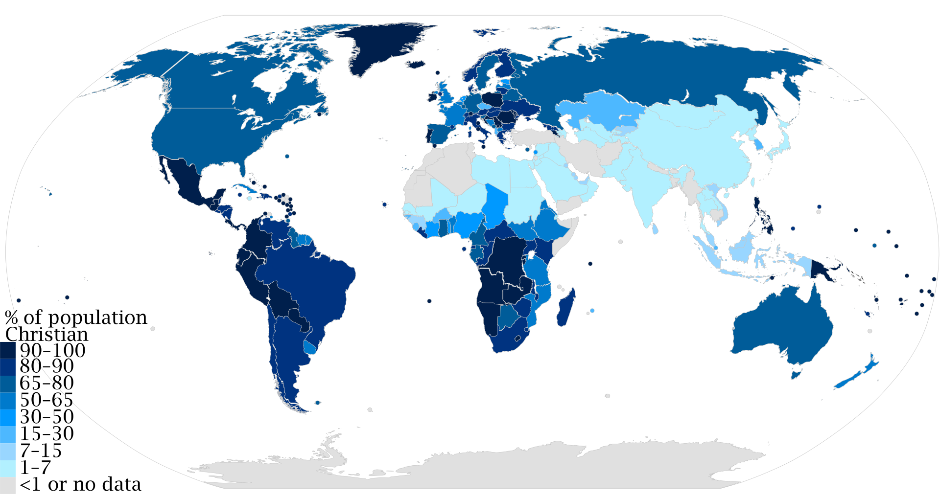
Percent of Population That’s Christian

Slide 9
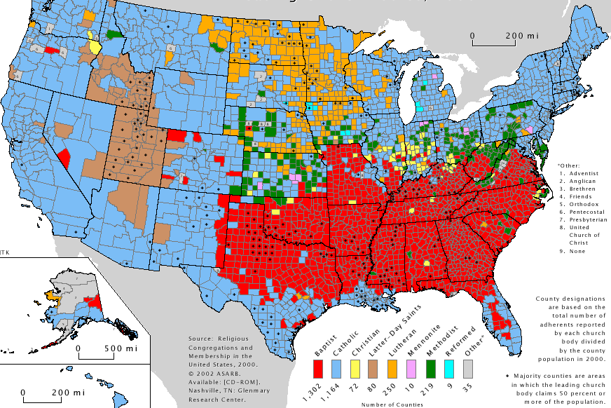
Christians In America
(by county)
America:
Catholic 62m
Baptist 32m
Pentecostal 13.6m
Methodist 11m
Lutheran 6.5m
(Mennonite Brethren 25,000)

Slide 10
This includes all new churches
²⁰ “I am praying not only for these disciples but also for all who will ever believe in me through their message.
²¹ I pray that they will all be one, just as you and I are one—as you are in me, Father, and I am in you. And may they be in us so that the world will believe you sent me.
Doesn’t matter the denomination, it’s all one Church
Unity produces momentum
John 17:20-21 NLT

Slide 11
History of the Church
ANABAPTIST
UNDIVIDED CHURCH
JESUS
30 CE
1000 CE
1500 CE
1700 CE
1800 CE
1900 CE
2000 CE

Slide 12
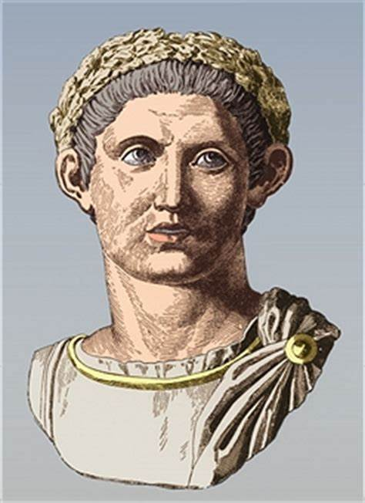
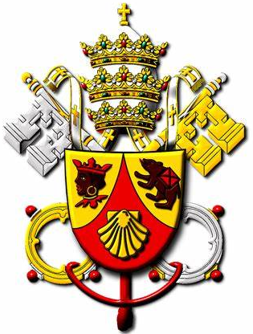
Emperor Constantine:
Christianity became the official religion of the Roman empire
Council of Nicea (318-325) to unify Christian doctrine
Creeds were written to help express core Christian beliefs
ANABAPTIST
Constantine's Conversion 312 CE
UNDIVIDED CHURCH
ROMAN CATHOLIC
JESUS
30 CE
1000 CE
1500 CE
1700 CE
1800 CE
1900 CE
2000 CE

Slide 13
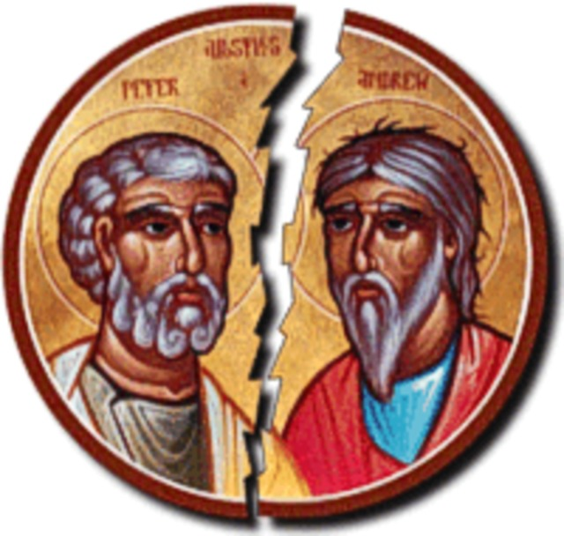
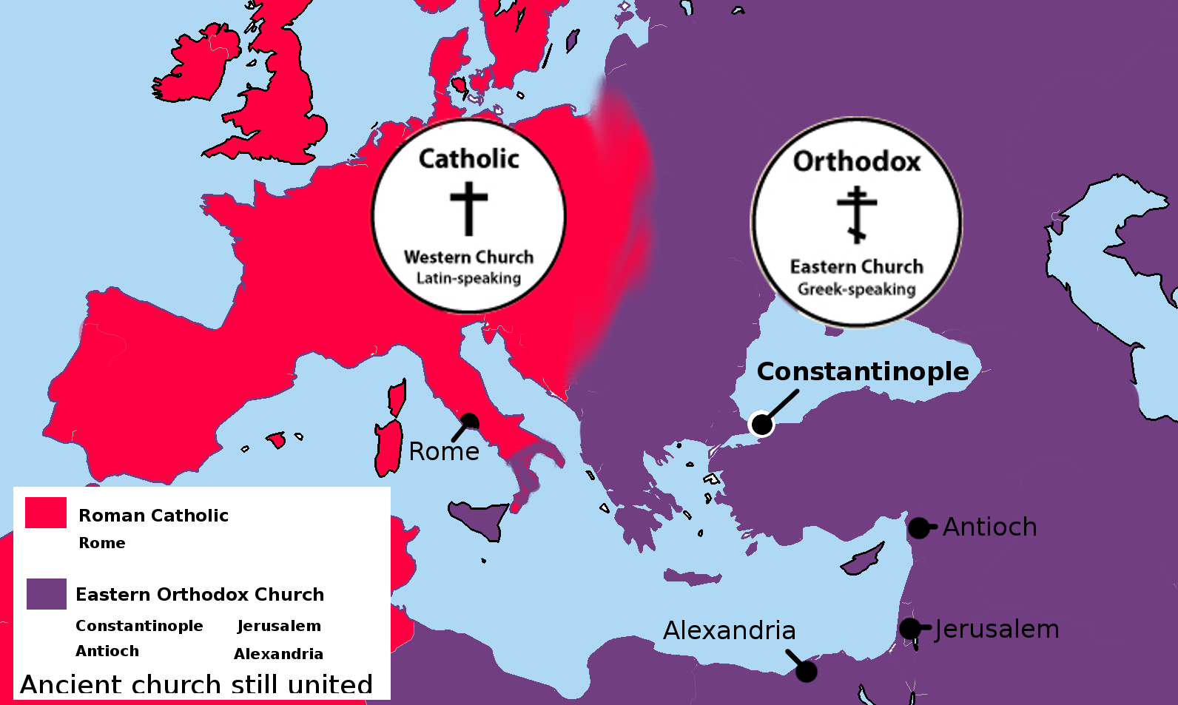
THE GREAT SCHISM 1054CE
EASTERN ORTHODOX
UNDIVIDED CHURCH
ROMAN CATHOLIC
JESUS
30 CE
1000 CE
1500 CE
1700 CE
1800 CE
1900 CE
2000 CE

Slide 14
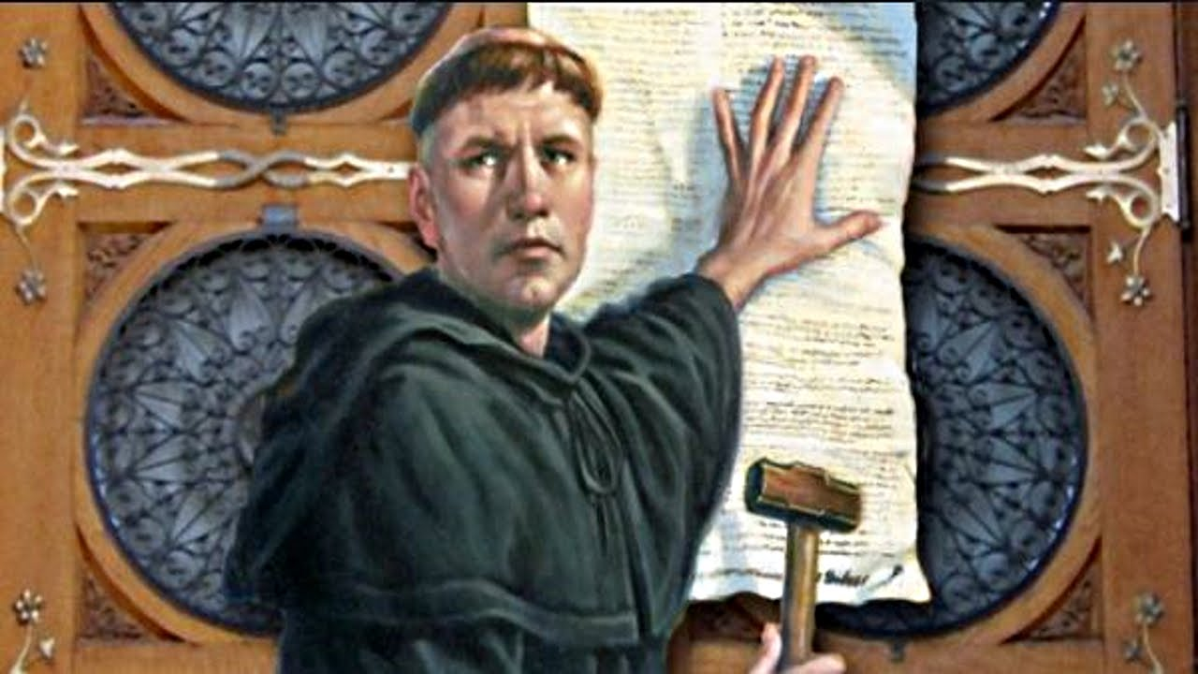
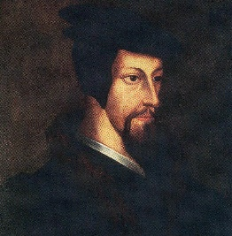
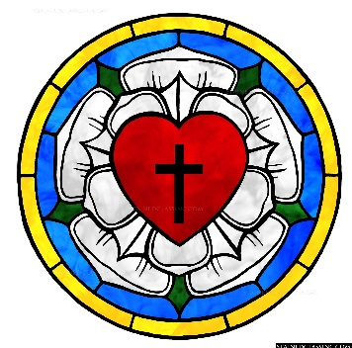
Fought against the sale of indulgence
Salvation is through GRACE with faith and not by works
Wrote the 95 thesis (disagreements with the Church)
Believed the Bible should be in the common language
ANABAPTIST
LUTHERAN | Martin Luther 1517 CE
PROTESTANT REFORMATION 1517CE
EASTERN ORTHODOX
UNDIVIDED CHURCH
ROMAN CATHOLIC
JESUS
30 CE
1000 CE
1500 CE
1700 CE
1800 CE
1900 CE
2000 CE

Slide 15
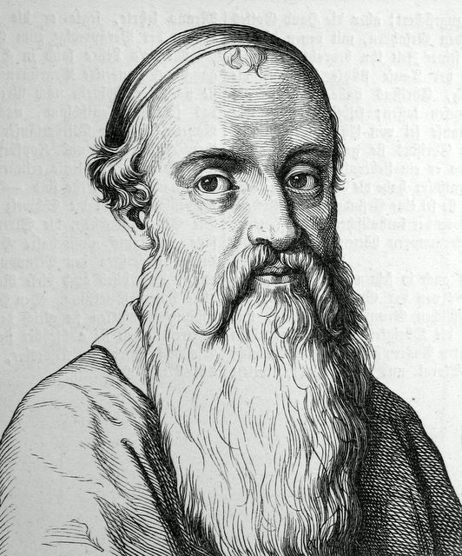
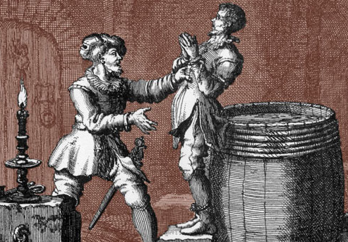
Started practicing believers baptism (after salvation)
Focused on pacifist practices
Was called Anabaptist meaning “re-baptizers”
Many were persecuted and even killed for this practice
ANABAPTIST
LUTHERAN | Martin Luther 1517 CE
MENNONITE | Menno Simons 1537 CE
EASTERN ORTHODOX
UNDIVIDED CHURCH
ROMAN CATHOLIC
JESUS
30 CE
1000 CE
1500 CE
1700 CE
1800 CE
1900 CE
2000 CE

Slide 16
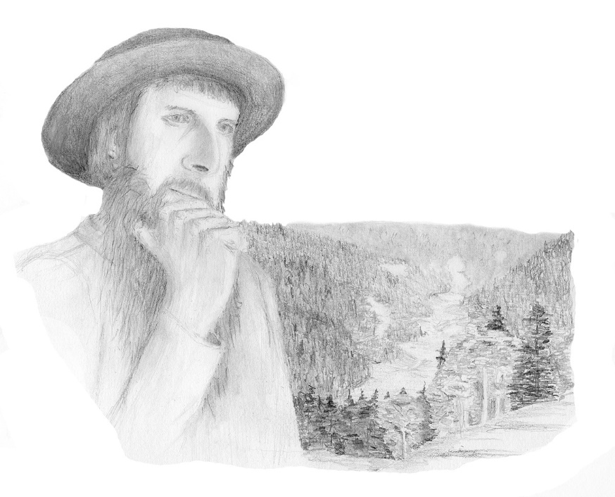
Believed culture would hurt their spiritual growth
Known for simple living, plain dress and slowness to adopt many conveniences of modern technology
Practices Christian pacifism
LUTHERAN | Martin Luther 1517 CE
MENNONITE | Menno Simons 1537 CE
AMISH| Jakob Ammann 1693 CE
EASTERN ORTHODOX
UNDIVIDED CHURCH
ROMAN CATHOLIC
JESUS
30 CE
1000 CE
1500 CE
1700 CE
1800 CE
1900 CE
2000 CE

Slide 17
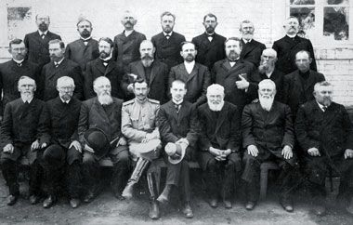
Started with a bible study of 16 families who wanted to get back to true faith (“direct from scripture”)
Rejected prosperity gospel that many Mennonites were practicing
Kept many of the same practices and an anti-violence stance
Many moved to Canada and USA
LUTHERAN | Martin Luther 1517 CE
MENNONITE | Menno Simons 1537 CE
MENNONITE BRETHREN | 1860 CE
AMISH| Jakob Ammann 1693 CE
EASTERN ORTHODOX
UNDIVIDED CHURCH
ROMAN CATHOLIC
JESUS
30 CE
1000 CE
1500 CE
1700 CE
1800 CE
1900 CE
2000 CE

Slide 18
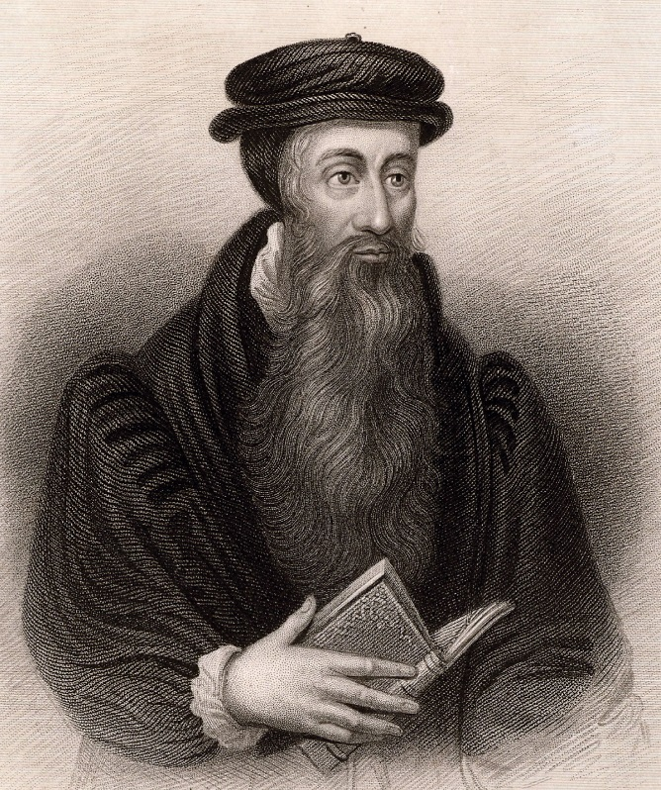
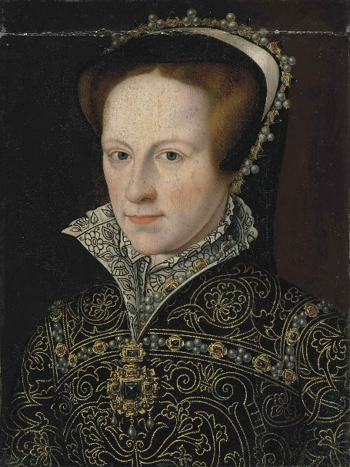
PRESBYTERIANS | John Knox 1538 CE
LUTHERAN | Martin Luther 1517 CE
MENNONITE | Menno Simons 1537 CE
MENNONITE BRETHREN | 1860 CE
Criticized many Catholic practices and queen Mary
Heavily influenced by Calvinism
Led the protestant reformation in Scotland
Believed the church should be led by “presbyters” (elders)
AMISH| Jakob Ammann 1693 CE
EASTERN ORTHODOX
UNDIVIDED CHURCH
ROMAN CATHOLIC
JESUS
30 CE
1000 CE
1500 CE
1700 CE
1800 CE
1900 CE
2000 CE
Notes:
They believe the church should be governed by elders or “presbyters”
Heavily influenced by John Calvin and Calvinism believes on salvation

Slide 19
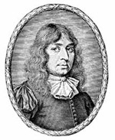
Focused on believer’s baptism
Rejected Calvinism
Rejected liturgy in their services (ritual prayers & spoken word)
BAPTIST | John Smyth 1609 CE
SOUTHERN | 1845
AMERICAN | 1924
PRESBYTERIANS | John Knox 1538 CE
LUTHERAN | Martin Luther 1517 CE
MENNONITE | Menno Simons 1537 CE
MENNONITE BRETHREN | 1860 CE
AMISH| Jakob Ammann 1693 CE
EASTERN ORTHODOX
UNDIVIDED CHURCH
ROMAN CATHOLIC
JESUS
30 CE
1000 CE
1500 CE
1700 CE
1800 CE
1900 CE
2000 CE
Notes:
Rejected

Slide 20
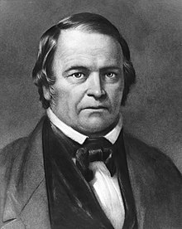
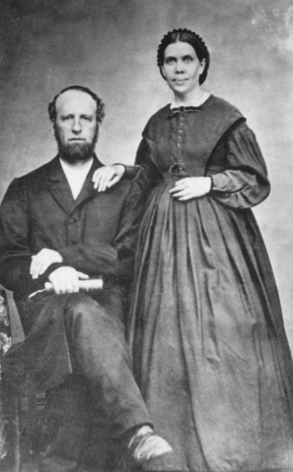
Maintained the Sabbath is on Saturday
William Miller prophesied the end of the world would be 1843CE (from Dan. 8:13-14)
Afterwards most of his followers left
SEVENTH DAY ADVENTIST | Ellen White 1831 CE
BAPTIST | John Smyth 1609 CE
SOUTHERN | 1845
AMERICAN | 1924
PRESBYTERIANS | John Knox 1538 CE
LUTHERAN | Martin Luther 1517 CE
Ellen White had a vision for church expansion & mission work in 1890CE
Adopted the doctrine of The Trinity in 1925CE
MENNONITE | Menno Simons 1537 CE
MENNONITE BRETHREN | 1860 CE
AMISH| Jakob Ammann 1693 CE
EASTERN ORTHODOX
UNDIVIDED CHURCH
ROMAN CATHOLIC
JESUS
30 CE
1000 CE
1500 CE
1700 CE
1800 CE
1900 CE
2000 CE

Slide 21
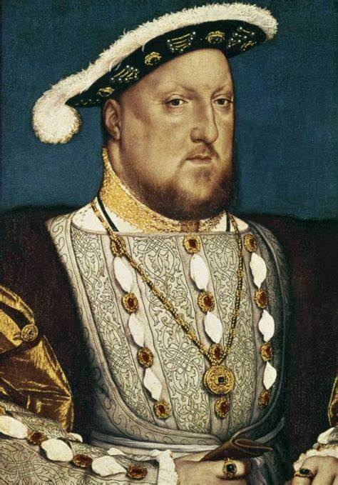
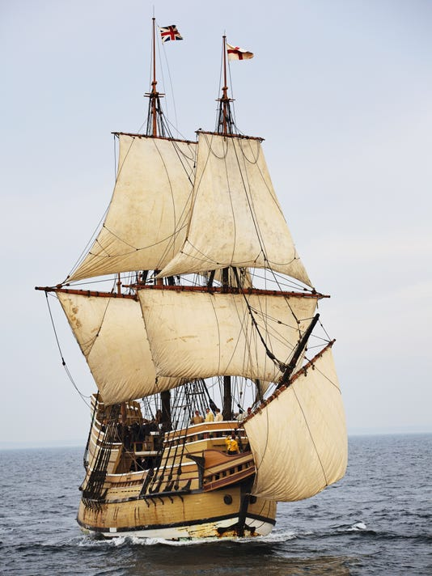
Anglican means “of England”
The British monarch is the supreme governor of the church
Anglican Puritans came to America on the Mayflower
SEVENTH DAY ADVENTIST | Ellen White 1831 CE
BAPTIST | John Smyth 1609 CE
SOUTHERN | 1845
AMERICAN | 1924
PRESBYTERIANS | John Knox 1538 CE
ANABAPTIST
LUTHERAN | Martin Luther 1517 CE
MENNONITE | Menno Simons 1537 CE
MENNONITE BRETHREN | 1860 CE
AMISH| Jakob Ammann 1693 CE
EASTERN ORTHODOX
UNDIVIDED CHURCH
ROMAN CATHOLIC
ANGLICAN | Henry VIII 1534 CE
CONGREGATIONAL | 1630
EPISCOPAL| 1789
JESUS
30 CE
1000 CE
1500 CE
1700 CE
1800 CE
1900 CE
2000 CE

Slide 22
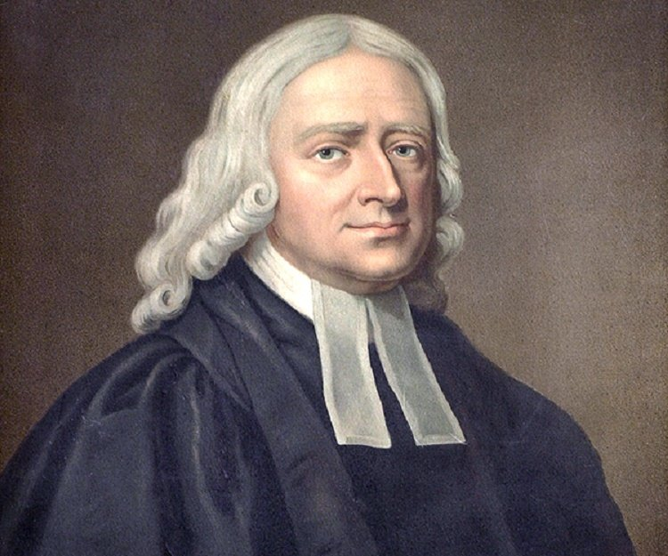
SEVENTH DAY ADVENTIST | Ellen White 1831 CE
Christianity should be practiced more “methodical”
More Arminian in belief
BAPTIST | John Smyth 1609 CE
SOUTHERN | 1845
AMERICAN | 1924
PRESBYTERIANS | John Knox 1538 CE
LUTHERAN | Martin Luther 1517 CE
MENNONITE | Menno Simons 1537 CE
MENNONITE BRETHREN | 1860 CE
AMISH| Jakob Ammann 1693 CE
EASTERN ORTHODOX
UNDIVIDED CHURCH
ROMAN CATHOLIC
ANGLICAN | Henry VIII 1534 CE
CONGREGATIONAL | 1630
EPISCOPAL| 1789
METHODIST | John Wesley 1738 CE
SALVATION ARMY | 1865
CHURCH OF THE NAZARENE | 1895
JESUS
30 CE
1000 CE
1500 CE
1700 CE
1800 CE
1900 CE
2000 CE

Slide 23
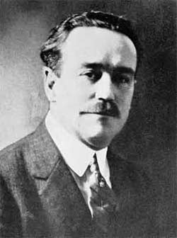
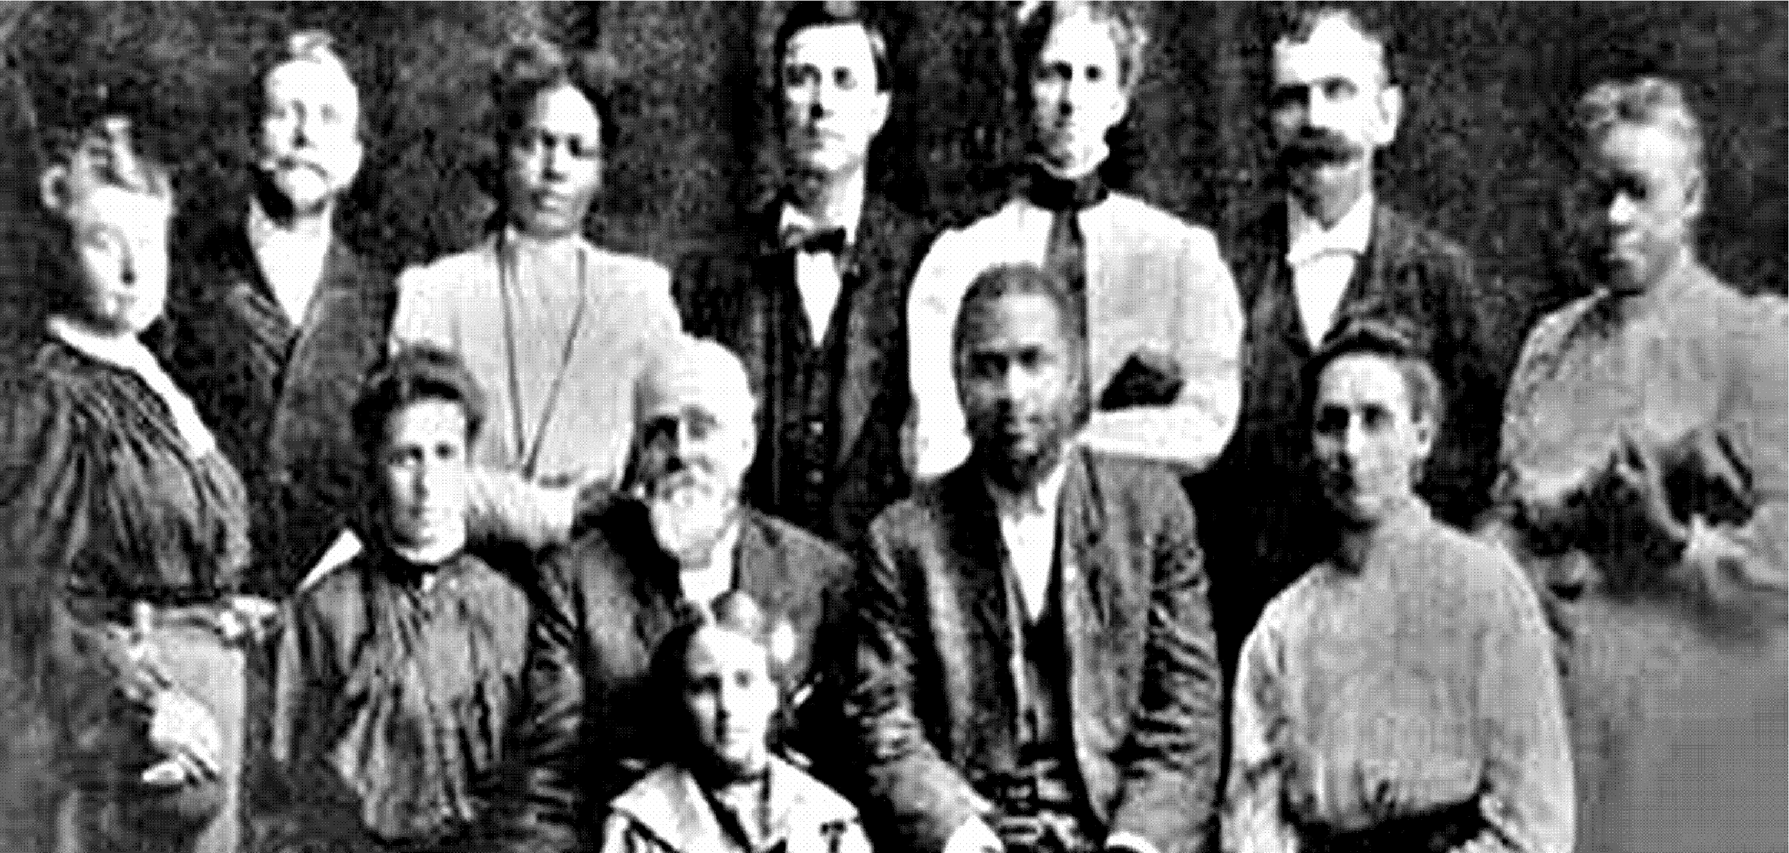
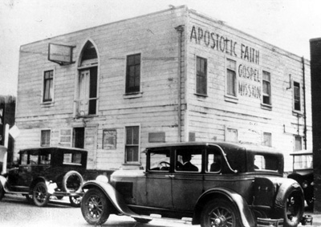
Charles Fox Parham (Topeka, KS)
Evidence of salvation is speaking in tongues
Outpouring of the Holy Spirit 1900-1915
Azusa Street Revival held services 3 times a day
SEVENTH DAY ADVENTIST | Ellen White 1831 CE
BAPTIST | John Smyth 1609 CE
SOUTHERN | 1845
AMERICAN | 1924
PRESBYTERIANS | John Knox 1538 CE
LUTHERAN | Martin Luther 1517 CE
MENNONITE | Menno Simons 1537 CE
MENNONITE BRETHREN | 1860 CE
AMISH| Jakob Ammann 1693 CE
EASTERN ORTHODOX
UNDIVIDED CHURCH
ROMAN CATHOLIC
ANGLICAN | Henry VIII 1534 CE
CONGREGATIONAL | 1630
EPISCOPAL| 1789
METHODIST | John Wesley 1738 CE
SALVATION ARMY | 1865
CHURCH OF THE NAZARENE | 1895
JESUS
CHURCH OF GOD | 1897
PENTECOSTALS | Charles Parham 1900
AZUZA STREET REVIVAL 1906CE
ASSEMBLIES OF GOD | 1914
FOURSQUARE | 1927
VINEYARD | 1983
30 CE
1000 CE
1500 CE
1700 CE
1800 CE
1900 CE
2000 CE

Slide 24
History
of the Church
SEVENTH DAY ADVENTIST | Ellen White 1831 CE
BAPTIST | John Smyth 1609 CE
SOUTHERN | 1845
AMERICAN | 1924
PRESBYTERIANS | John Knox 1538 CE
LUTHERAN | Martin Luther 1517 CE
MENNONITE | Menno Simons 1537 CE
MENNONITE BRETHREN | 1860 CE
AMISH| Jakob Ammann 1693 CE
EASTERN ORTHODOX
UNDIVIDED CHURCH
ROMAN CATHOLIC
ANGLICAN | Henry VIII 1534 CE
CONGREGATIONAL | 1630
EPISCOPAL| 1789
METHODIST | John Wesley 1738 CE
SALVATION ARMY | 1865
CHURCH OF THE NAZARENE | 1895
JESUS
CHURCH OF GOD | 1897
PENTECOSTALS | Charles Parham 1900
ASSEMBLIES OF GOD | 1914
Assembled by Kyle Goings
controlled.chaosx2@gmail.com
FOURSQUARE | 1927
VINEYARD | 1983
30 CE
1000 CE
1500 CE
1700 CE
1800 CE
1900 CE
2000 CE

Slide 25
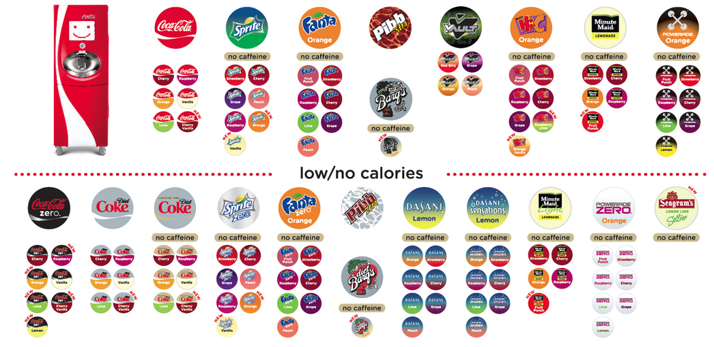
The Flavors of Coke-Cola Company
Notes:
Just like COKE which started with just one flavor as the world changed and grew so did the number of flavors of coke. It is the same with church denominations.

Slide 26
Do you know the difference between ESSENTIALS and PREFERENCES?

Slide 27
What Should You Look For In A Church?
Level 1: Essentials
Absolutely necessary;
extremely important
Level 2: Convictions
Firmly held beliefs
Level 3: Preferences
A greater liking to one
thing over another
Notes:
At this time I had them get into groups and write out their own levels

Slide 28
Usage of spiritual gifts
View on social issues
Baptism
Deity of Jesus
Belief in the trinity
Preaching style
Age specific ministry
View of end times
Church membership
Salvation Requirements
Authority of the scriptures
Church building
Practice of Communion
Gender roles
Diversity of the people
Worship style
Community work
Missional work
Equipping to serve
Dress code
.
Small Groups
Age of congregation
View of Saints
Other
Level 1:
Essentials
Level 2: Convictions
Level 3: Preferences
Notes:
Have them fill out what would be their essentials, convitions, and preferences

Slide 29
What’s the DIFFERENCE With Each Denomination?

Slide 30
Conclusion to the Sermon on the Mount
²¹ “Not everyone who calls out to me, ‘Lord! Lord!’ will enter the Kingdom of Heaven. Only those who actually do the will of my Father in heaven will enter.
²² On judgment day many will say to me, ‘Lord! Lord! We prophesied in your name and cast out demons in your name and performed many miracles in your name.’
²³ But I will reply, ‘I never knew you. Get away from me, you who break God’s laws.’
Even people who preached God’s Word!
They did it for their own glory not God’s
You CANNOT EARN your way into heaven, no matter the deed
Matthew 7:21-23 NLT

Slide 31
Differing Denominational Beliefs & Practices
FORGIVENESS

Slide 32
CATHOLIC
PROTESTANT
FORGIVENESS

Slide 33
Differing Denominational Beliefs & Practices
FORGIVENESS
EASTERN ORTHODOX
ROMAN
CATHOLIC

Slide 34
Differing Denominational Beliefs & Practices
Orthodox means “accepted, standard, right”
(Official name is The Orthodox Catholic Church)
FORGIVENESS
EASTERN ORTHODOX
Does not consider itself a denomination
but the true Church
Catholic means “universal”
ROMAN
CATHOLIC

Slide 35
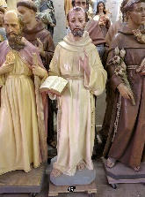
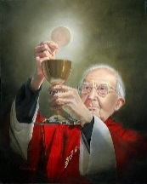
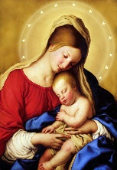
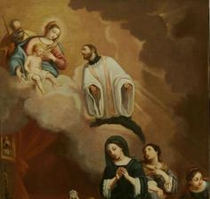
Differing Denominational Beliefs & Practices
ICONS
TRANSUBSTANTIATION
FORGIVENESS
EASTERN ORTHODOX
VENERIATION OF MARY
INTERCESSIONOF SAINTS
APOCRYPHA
ROMAN
CATHOLIC

Slide 36
Differing Denominational Beliefs & Practices
God or his spirit can be in physical objects, usually to bring about miracles when touched or prayed to.
ICONS
TRANSUBSTANTIATION
FORGIVENESS
EASTERN ORTHODOX
“Queen of Heaven”
She was born immaculate, stayed sinless, remained a virgin, and that God took her body to heaven.
VENERIATION OF MARY
INTERCESSIONOF SAINTS
APOCRYPHA
ROMAN
CATHOLIC
Notes:
(Can be a form of idolatry – see Exodus 20:4-5)
(Not in Scripture – see Luke 11:27-28; Matt. 12:47-50)

Slide 37
Differing Denominational Beliefs & Practices
The bread and wine of communion miraculously changes to the actual body and blood of Christ. For everyone who takes communion every time.
ICONS
TRANSUBSTANTIATION
FORGIVENESS
EASTERN ORTHODOX
People pray to saints and the saints
pray to God on their behalf.
VENERIATION OF MARY
INTERCESSIONOF SAINTS
APOCRYPHA
Apocrypha means “hidden books”
14 books written during the time of “the great silence” where God did not speak for 400 years.
ROMAN
CATHOLIC
Notes:
(not in scripture – see 1 Tim. 2:5-6)

Slide 38
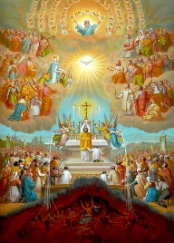
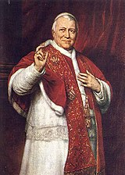
Differing Denominational Beliefs & Practices
ICONS
TRANSUBSTANTIATION
FORGIVENESS
EASTERN ORTHODOX
VENERIATION OF MARY
Purgatory means “to burn off”
Jesus’ sacrifice DOES NOT remove all sin, but only those sins committed before repentance and baptism. Those sins committed afterwards are on the believer’s head and must be “dealt with” in purgatory.
INTERCESSIONOF SAINTS
APOCRYPHA
ROMAN
CATHOLIC
PURGATORY
PAPAL AUTHORITY
Notes:
Christ’s sacrifice on the cross DOES NOT remove all sin, but only those sins committed before repentance and baptism. Those committed afterwards are on the Christian’s head. After death many Christians must go to a hell like place (it means to burn off) to burn off the sin that christ’s sacrifice failed to remove, suffering in many cases for centuries.
No belief is in the Bible, it became around the year 600 with Gregory the Great who received information about Purgatory in visions.
Hebrews 10:”14 and Romans 8:1 Hebrews 10:10 say otherwise

Slide 39
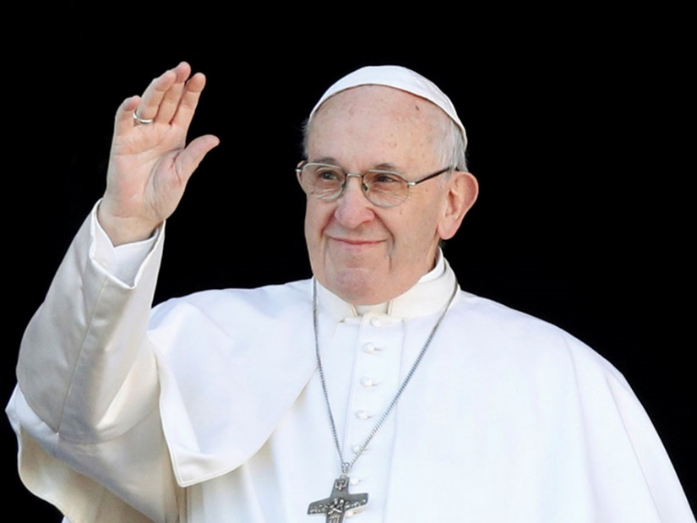
Differing Denominational Beliefs & Practices
ICONS
TRANSUBSTANTIATION
FORGIVENESS
Pope Francis is the 266th leader of the church
EASTERN ORTHODOX
VENERIATION OF MARY
The Pope is the supreme spiritual leader of the Church
Controls church doctrine. The apostle Peter was considered the first Pope. The Pope became infallible (incapable of making mistakes or being wrong)
in the year 1870.
INTERCESSIONOF SAINTS
APOCRYPHA
ROMAN
CATHOLIC
PURGATORY
PAPAL AUTHORITY

Slide 40
Differing Denominational Beliefs & Practices
ICONS
TRANSUBSTANTIATION
FORGIVENESS
Adam & Eve’s Decision Brought
Sin Into The World (Gen. 3:3)
Belief A: Adam’s sin is spiritually and physically inherited to all humankind
Belief B: Adam’s sin broke the spiritual ‘connection’ humans have with God
EASTERN ORTHODOX
VENERIATION OF MARY
INTERCESSIONOF SAINTS
APOCRYPHA
INFANT BAPTISM
ROMAN
CATHOLIC
PURGATORY
PAPAL AUTHORITY
ORIGINAL SIN

Slide 41
Differing Denominational Beliefs & Practices
Baptism = Salvation
(or at least removal of original sin)
They treat infant baptism as a new covenant equivalent of circumcision (it was required to join Hebrew or Mosaic covenants).
ICONS
TRANSUBSTANTIATION
FORGIVENESS
EASTERN ORTHODOX
VENERIATION OF MARY
INTERCESSIONOF SAINTS
APOCRYPHA
INFANT BAPTISM
Adam & Eve’s Decision Brought Sin Into The World (Gen. 3:3)
Belief A: Adam’s sin is spiritually and physically inherited to all humankind
Belief B: Adam’s sin broke the spiritual ‘connection’ humans have with God
ROMAN
CATHOLIC
PURGATORY
PAPAL AUTHORITY
ORIGINAL SIN

Slide 42
Differing Denominational Beliefs & Practices
EVANGELICAL PROTESTANT
ICONS
TRANSUBSTANTIATION
Baptist/Southern
Church of Christ
Mennonite/Brethren
Salvation Army
FORGIVENESS
EASTERN ORTHODOX
VENERIATION OF MARY
INTERCESSIONOF SAINTS
Methodist/Wesleyan
Episcopal/Anglican
Lutheran (ELS)
Disciples of Christ
Presbyterian
Quakers
National Baptist
APOCRYPHA
INFANT BAPTISM
ROMAN
CATHOLIC
MAINLINE
PROTESTANT
PURGATORY
PAPAL AUTHORITY
ORIGINAL SIN

Slide 43
Differing Denominational Beliefs & Practices
EVANGELICAL PROTESTANT
From the word “evangel” which means
“the good news of Jesus coming to save humanity.”
The Bible is inerrant: without error or fault in all its teaching
Emphasis on personal CONVERSION
ICONS
TRANSUBSTANTIATION
Baptist/Southern
Church of Christ
Mennonite/Brethren
Salvation Army
FORGIVENESS
EASTERN ORTHODOX
VENERIATION OF MARY
INTERCESSIONOF SAINTS
Methodist/Wesleyan
Episcopal/Anglican
Lutheran (ELS)
Disciples of Christ
Presbyterian
Quakers
National Baptist
“Oldline” denominations with a rich heritage and
similar theological beliefs
Modernity: Scriptures need to be seen in light of their historical context and interpreted through today’s culture
Emphasis on a spiritual lifelong JOURNEY
APOCRYPHA
INFANT BAPTISM
ROMAN
CATHOLIC
MAINLINE
PROTESTANT
PURGATORY
PAPAL AUTHORITY
ORIGINAL SIN

Slide 44
Differing Denominational Beliefs & Practices
EVANGELICAL PROTESTANT
ICONS
TRANSUBSTANTIATION
Three levels of Christ’s blood & body represented by the bread and drink:
1) LITTERALLY PRESENT: “in, with, and under”
2) SPIRITUALLY PRESENT: with the two elements
3) REMEMBRANCE: only symbolic in nature
Baptist/Southern
Church of Christ
Mennonite/Brethren
Salvation Army
FORGIVENESS
EASTERN ORTHODOX
VENERIATION OF MARY
INTERCESSIONOF SAINTS
Methodist/Wesleyan
Episcopal/Anglican
Lutheran (ELS)
Disciples of Christ
Presbyterian
Quakers
National Baptist
COMMUNION
APOCRYPHA
INFANT BAPTISM
ROMAN
CATHOLIC
MAINLINE
PROTESTANT
PURGATORY
PAPAL AUTHORITY
ORIGINAL SIN

Slide 45
Differing Denominational Beliefs & Practices
EVANGELICAL PROTESTANT
ICONS
TRANSUBSTANTIATION
BELIEVER’SBAPTISM
Baptist/Southern
Church of Christ
Mennonite/Brethren
Salvation Army
FORGIVENESS
EASTERN ORTHODOX
VENERIATION OF MARY
Baptism After Repentance:
Symbolically shows that you have already BEEN saved.
(some practice immersion while others accept pouring or sprinkling)
INTERCESSIONOF SAINTS
Methodist/Wesleyan
Episcopal/Anglican
Lutheran (ELS)
Disciples of Christ
Presbyterian
Quakers
National Baptist
COMMUNION
APOCRYPHA
INFANT BAPTISM
ROMAN
CATHOLIC
MAINLINE
PROTESTANT
PURGATORY
PAPAL AUTHORITY
ORIGINAL SIN

Slide 46
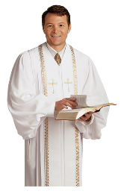
Differing Denominational Beliefs & Practices
EVANGELICAL PROTESTANT
BIBLE TEACHING
ICONS
TRANSUBSTANTIATION
BELIEVER’SBAPTISM
Baptist/Southern
Church of Christ
Mennonite/Brethren
Salvation Army
FORGIVENESS
EASTERN ORTHODOX
VENERIATION OF MARY
INTERCESSIONOF SAINTS
Methodist/Wesleyan
Episcopal/Anglican
Lutheran (ELS)
Disciples of Christ
Presbyterian
Quakers
National Baptist
COMMUNION
APOCRYPHA
INFANT BAPTISM
ROMAN
CATHOLIC
LITURGICAL
MAINLINE
PROTESTANT
PURGATORY
PAPAL AUTHORITY
ORIGINAL SIN

Slide 47
Differing Denominational Beliefs & Practices
EVANGELICAL PROTESTANT
Evangelical services tend to have more experiential worship and direct Bible interpretation teaching
Mainline services are liturgical which means ceremonial in style based on rituals with prescripted prayers and creeds
BIBLE TEACHING
ICONS
TRANSUBSTANTIATION
BELIEVER’SBAPTISM
Baptist/Southern
Church of Christ
Mennonite/Brethren
Salvation Army
FORGIVENESS
EASTERN ORTHODOX
VENERIATION OF MARY
INTERCESSIONOF SAINTS
Methodist/Wesleyan
Episcopal/Anglican
Lutheran (ELS)
Disciples of Christ
Presbyterian
Quakers
National Baptist
COMMUNION
APOCRYPHA
INFANT BAPTISM
ROMAN
CATHOLIC
LITURGICAL
MAINLINE
PROTESTANT
PURGATORY
PAPAL AUTHORITY
ORIGINAL SIN

Slide 48
Differing Denominational Beliefs & Practices
EVANGELICAL PROTESTANT
BIBLE TEACHING
ICONS
TRANSUBSTANTIATION
BELIEVER’SBAPTISM
Baptist/Southern
Church of Christ
Mennonite/Brethren
Salvation Army
FORGIVENESS
EASTERN ORTHODOX
Due to their view of scripture interpretation many but not all ordain or accept members in the LGBTQ+ community
Modernity: Scriptures need to be seen in light of their historical context and interpreted through today’s culture
VENERIATION OF MARY
INTERCESSIONOF SAINTS
Methodist/Wesleyan
Episcopal/Anglican
Lutheran (ELS)
Disciples of Christ
Presbyterian
Quakers
National Baptist
COMMUNION
ORDAINS
LGBTQ+
APOCRYPHA
INFANT BAPTISM
ROMAN
CATHOLIC
LITURGICAL
MAINLINE
PROTESTANT
PURGATORY
PAPAL AUTHORITY
ORIGINAL SIN

Slide 49
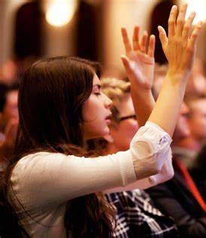
Differing Denominational Beliefs & Practices
EVANGELICAL PROTESTANT
CHARISMATIC
BIBLE TEACHING
ICONS
TRANSUBSTANTIATION
BELIEVER’SBAPTISM
Baptist/Southern
Church of Christ
Mennonite Brethren
Salvation Army
Assembly of God
Pentecostal
Foursquare Gospel
Vineyard USA
FORGIVENESS
EASTERN ORTHODOX
High emphasis on spiritual gifts, particularly speaking in tongues (some believe it’s required).
Many believe in “second blessing” which means a believer can become sinless through sanctification.
VENERIATION OF MARY
INTERCESSIONOF SAINTS
Methodist/Wesleyan
Episcopal/Anglican
Lutheran (ELS)
Disciples of Christ
Presbyterian
Quakers
National Baptist
COMMUNION
ORDAINS
LGBTQ+
APOCRYPHA
INFANT BAPTISM
ROMAN
CATHOLIC
LITURGICAL
MAINLINE
PROTESTANT
PURGATORY
PAPAL AUTHORITY
ORIGINAL SIN

Slide 50
Differing Denominational Beliefs & Practices
Seventh Day Adventist
SATURDAY SABBATH
EVANGELICAL PROTESTANT
CHARISMATIC
BIBLE TEACHING
ICONS
TRANSUBSTANTIATION
BELIEVER’SBAPTISM
Baptist/Southern
Church of Christ
Mennonite/Brethren
Salvation Army
Assembly of God
Pentecostal
Foursquare Gospel
Vineyard USA
Believes in the OT Sabbath of Saturday
Believe death is an unconscious state, until Jesus returns we all lay dormant.
More legalistic (avoids alcohol, tobacco, drugs, movies, tv, etc.)
FORGIVENESS
EASTERN ORTHODOX
VENERIATION OF MARY
INTERCESSIONOF SAINTS
Methodist/Wesleyan
Episcopal/Anglican
Lutheran (ELS)
Disciples of Christ
Presbyterian
Quakers
National Baptist
COMMUNION
APOCRYPHA
ORDAINS
LGBTQ+
INFANT BAPTISM
ROMAN
CATHOLIC
LITURGICAL
MAINLINE
PROTESTANT
PURGATORY
PAPAL AUTHORITY
ORIGINAL SIN

Slide 51
Differing Denominational Beliefs & Practices
Seventh Day Adventist
SATURDAY SABBATH
EVANGELICAL PROTESTANT
CHARISMATIC
BIBLE TEACHING
ICONS
TRANSUBSTANTIATION
BELIEVER’SBAPTISM
Baptist/Southern
Church of Christ
Mennonite/Brethren
Salvation Army
Assembly of God
Pentecostal
Foursquare Gospel
Vineyard USA
FORGIVENESS
EASTERN ORTHODOX
VENERIATION OF MARY
INTERCESSIONOF SAINTS
Methodist/Wesleyan
Episcopal/Anglican
Lutheran (ELS)
Disciples of Christ
Presbyterian
Quakers
National Baptist
COMMUNION
APOCRYPHA
ORDAINS
LGBTQ+
INFANT BAPTISM
ROMAN
CATHOLIC
LITURGICAL
MAINLINE
PROTESTANT
PURGATORY
PAPAL AUTHORITY
Inspired by CornerTalker and Compare the Beliefs of Christian Denominations by Mary Fairchild
Assembled by Kyle Goings controlled.chaosx2@gmail.com
ORIGINAL SIN

Slide 52
Why aren’t Mormons and
Jehovah’s Witness a Christian Denomination?
Doctrine | Christian Bible | Mormon | Jehovah’s Witness
View of God & The Trinity | Eternal God in 3 persons (Isiah 43:10-11) | 3 Separate Gods “God has not always been God. He is not a spirit but is an “exalted man” (Teachings of the Prophet Joseph Smith p. 345) | Jesus is a lesser “god” under Jehovah the only true God. Holy Spirit simply is God’s “active force” (Reasons from the Scriptures p. 212)
Jesus Christ | The eternal God, the Son (John 1:1-3) | Earn his godhood and salvation. Certain sins for which Jesus’ blood cannot atone (ex. murder) (Mormon doctrine p. 129; Gospel Principles p. 17-18) | A created angel who is “divine” and next to but not equal to Jehovah God. Jesus is not worthy of prayer or worship. (Reasons from the Scriptures p. 218 & Insights on the scriptures vol. 2 p. 667)
Gospel | Free gift of grace through the death & resurrection of Jesus Christ by faith (Rom. 4:4-6; 6:23) | Faith in Jesus PLUS works of obedience to L.D.S. “laws” (Miracle of Forgiveness p. 6) | Faith in Jehovah God, Jesus, and the Watchtower Organization PLUS works to “prove oneself” (The Watchtower Feb. 15 ‘83 and Aug. 15 ‘72)
Fundamental Differing Doctrines

Slide 53
What about
non-denominational churches?

Slide 54
Differing Denominational Beliefs & Practices
Seventh Day Adventist
SATURDAY SABBATH
EVANGELICAL PROTESTANT
CHARISMATIC
BIBLE TEACHING
ICONS
TRANSUBSTANTIATION
BELIEVER’SBAPTISM
Baptist/Southern
Church of Christ
Mennonite/Brethren
Salvation Army
Assembly of God
Pentecostal
Foursquare Gospel
Vineyard USA
FORGIVENESS
EASTERN ORTHODOX
VENERIATION OF MARY
INTERCESSIONOF SAINTS
Methodist/Wesleyan
Episcopal/Anglican
Lutheran (ELS)
Disciples of Christ
Presbyterian
Quakers
National Baptist
COMMUNION
APOCRYPHA
ORDAINS
LGBTQ+
INFANT BAPTISM
ROMAN
CATHOLIC
LITURGICAL
MAINLINE
PROTESTANT
PURGATORY
PAPAL AUTHORITY
ORIGINAL SIN
Notes:
Non-denomination churches can be anywhere on this chart because each church holds different standards and even beliefs.

Slide 56
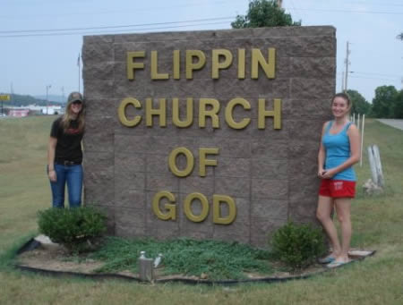
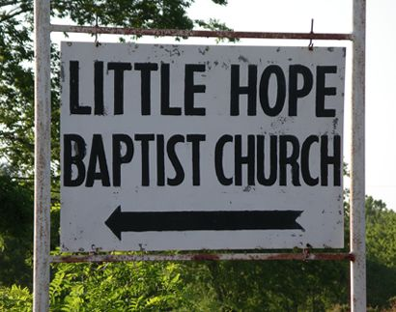
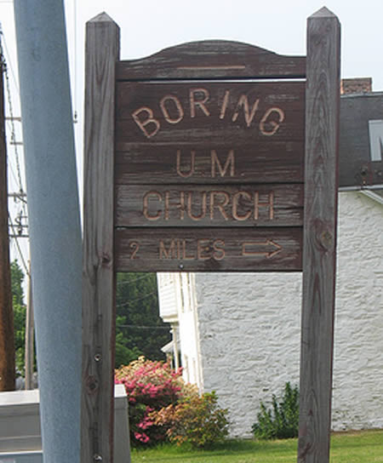
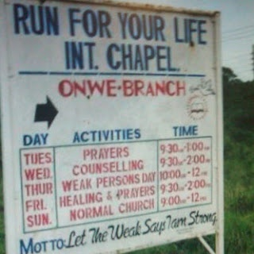
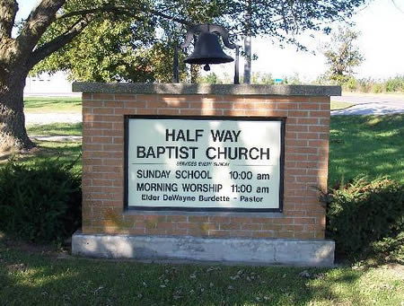
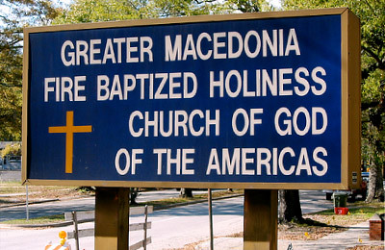

Slide 59
Printable Slides

Slide 60
Usage of spiritual gifts
View on social issues
Baptism
Deity of Jesus
Belief in the trinity
Preaching style
Age specific ministry
View of end times
Church membership
Salvation Requirements
Authority of the scriptures
Church building
Practice of Communion
Gender roles
Diversity of the people
Worship style
Community work
Missional work
Equipping to serve
Dress code
.
Small Groups
Age of congregation
View of Saints
Other
Level 1:
Essentials
Level 2: Convictions
Level 3: Preferences
Notes:
Have them fill out what would be their essentials, convitions, and preferences

Slide 61
What Should You Look For In A Church?
(example)
Deity
of Jesus
The trinity
Salvation through
grace by faith
Authority of the scriptures
Level 1: Essentials
Level 2: Convictions
Ecclesiology
Communion
Gender roles
Usage of spiritual gifts
View on social issues
Baptism
Level 3: Preferences
Preaching style
Age specific ministry
View of end times
Church membership
Worship style
Community and missional work
Equipping to serve
Dress code

Slide 62
History
of the Church
SEVENTH DAY ADVENTIST | Ellen White 1831 CE
BAPTIST | John Smyth 1609 CE
SOUTHERN | 1845
AMERICAN | 1924
PRESBYTERIANS | John Knox 1538 CE
LUTHERAN | Martin Luther 1517 CE
MENNONITE | Menno Simons 1537 CE
MENNONITE BRETHREN | 1860 CE
AMISH| Jakob Ammann 1693 CE
EASTERN ORTHODOX
UNDIVIDED CHURCH
ROMAN CATHOLIC
ANGLICAN | Henry VIII 1534 CE
CONGREGATIONAL | 1630
EPISCOPAL| 1789
METHODIST | John Wesley 1738 CE
SALVATION ARMY | 1865
CHURCH OF THE NAZARENE | 1895
JESUS
CHURCH OF GOD | 1897
PENTECOSTALS | Charles Parham 1900
ASSEMBLIES OF GOD | 1914
Assembled by Kyle Goings
controlled.chaosx2@gmail.com
FOURSQUARE | 1927
VINEYARD | 1983
30 CE
1000 CE
1500 CE
1700 CE
1800 CE
1900 CE
2000 CE

Slide 63
Differing Denominational Beliefs & Practices
Seventh Day Adventist
SATURDAY SABBATH
EVANGELICAL PROTESTANT
CHARISMATIC
BIBLE TEACHING
ICONS
TRANSUBSTANTIATION
Baptist/Southern
Church of Christ
Mennonite/Brethren
Salvation Army
Assembly of God
Pentecostal
Foursquare Gospel
Vineyard USA
BELIEVER’SBAPTISM
FORGIVENESS
EASTERN ORTHODOX
VENERIATION OF MARY
INTERCESSIONOF SAINTS
Methodist/Wesleyan
Episcopal/Anglican
Lutheran (ELS)
Disciples of Christ
Presbyterian
Quakers
National Baptist
COMMUNION
APOCRYPHA
ORDAINS
LGBTQ+
INFANT BAPTISM
ROMAN
CATHOLIC
LITURGICAL
MAINLINE
PROTESTANT
PURGATORY
PAPAL AUTHORITY
Inspired by Compare the Beliefs of Christian Denominations by Mary Fairchild
Assembled by Kyle Goings controlled.chaosx2@gmail.com
ORIGINAL SIN

